Slide 1
How To Write A Good Title For Journal Article?
Jieun, Victoria, Angie, Dylan, Yuan

Slide 2
?
What is the title role?
The title, plays a pivotal role in the communication of research.
Readers will deduce what your paper is about based on the title

Slide 3
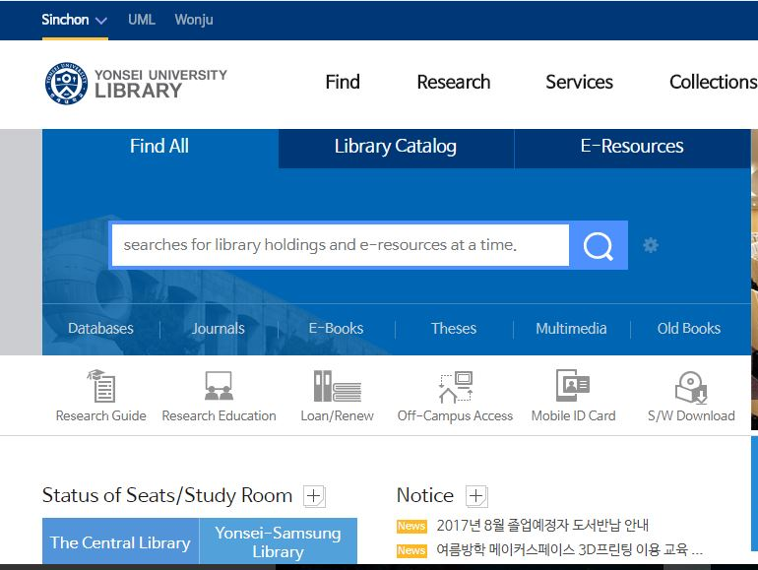
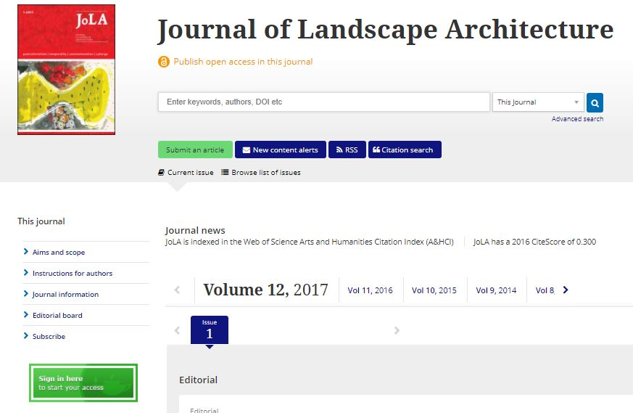
?
why?
Influences the impact of your work + number of readers it will attract-
Without a title, your paper may never be read or even found by interested readers.
Int. Journal of Interior Architecture + Spatial Design
Search option – KEY WORDS
Readers come across research paper titles in searches through databases and reference sections of research papers.
They deduce what a paper is about and its relevance to them based on the title.
Journal of Landscape and Architecture
Yonsei University Library Search engine

Slide 4
How To Write A Good Title For Journal Article?

Slide 5
Start With A Draft
Steps:
Answer the questions:
What is my paper about?
What techniques/ designs were used?
What is studied?
What were the results?
Use answers to list key words
Build a sentence with the listed key words
Delete all unnecessary words and repetitive words; link the remaining
Delete non-essential information and reword
Example
My paper studies whether X therapy improves the cognitive function of patients suffering from dementia. It was randomized trial. I studied 40 cases from six cities in Japan. There was an improvement in the cognitive function of patients.
Notes:
Writing a paper can be a lengthy process that may take anything from a few days to several months. During this time, it is natural to decide to change some aspects of your paper or to come up with new ideas that you haven’t thought of before. That’s why, it’s a good idea to start with a draft title in the beginning and then focus on writing the rest of the paper.

Slide 6
Start With A Draft
Steps:
Answer the questions:
What is my paper about?
What techniques/ designs were used?
What is studied?
What were the results?
Use answers to list key words
Build a sentence with the listed key words
Delete all unnecessary words and repetitive words; link the remaining
Delete non-essential information and reword
Example
X therapy Randomized trial Dementia 6 Japanese cities 40 cases Improved cognitive function

Slide 7
Start With A Draft
Steps:
Answer the questions:
What is my paper about?
What techniques/ designs were used?
What is studied?
What were the results?
Use answers to list key words
Build a sentence with the listed key words
Delete all unnecessary words and repetitive words; link the remaining
Delete non-essential information and reword
Example
This study is a randomized trial that investigates whether X therapy improved cognitive function in 40 dementia patients from 6 cities in Japan; it reports improved cognitive function. (28 words)

Slide 8
Start With A Draft
Steps:
Answer the questions:
What is my paper about?
What techniques/ designs were used?
What is studied?
What were the results?
Use answers to list key words
Build a sentence with the listed key words
Delete all unnecessary words (e.g. study of, investigates) and repetitive words; link the remaining
Delete non-essential information and reword
Example
This study is a randomized trial that investigates whether X therapy improved cognitive function in 40 dementia patients from 6 cities in Japan; it reports improved cognitive function. (28 words) This study is a randomized trial that investigates whether X therapy improved cognitive function in 40 dementia patients from 6 cities in Japan; it reports improved cognitive function (19 words)

Slide 9
Start With A Draft
Steps:
Answer the questions:
What is my paper about?
What techniques/ designs were used?
What is studied?
What were the results?
Use answers to list key words
Build a sentence with the listed key words
Delete all unnecessary words and repetitive words; link the remaining
Delete non-essential information and reword
Example
Randomized trial X therapy improved cognitive function in 40 dementia patients from 6 cities in Japan; improved cognitive function (19 words) Randomized trial of X therapy for improving cognitive function in 40 dementia patients from 6 cities in Japan; improved cognitive function (13 words)

Slide 10
Choose What Type You Want To Use
1. Declarative titles :
State the main findings or conclusions.
2. Descriptive titles :
Describe the subject of the article but do not
reveal the main conclusions.
3. Interrogative titles :
Introduce the subject in the form of a question.
Example
A three-month weight loss program increases self-esteem in adolescent girls
Example
The effects of family support on patients with dementia
Example
Does cognitive training improve performance on pattern recognition tasks?
Notes:
Each of these three types is useful and you should choose a format depending on what kind of information you want to convey to your audience.
Declarative titles are generally used in research articles and they convey the largest amount of information.
On the other hand, are less common and they are more suitable for literature review articles.
But out of the three, descriptive titles seem to be most common type in journals

Slide 11
How To Formulate Your Title?
Follow the guidelines of the Publication Manual of the APA
Avoid titles that are too long. (no more than 12 words)
Use a colon to add additional information to the title such as the methodology
(e.g., ‘Brain activation during perception of face-like stimuli: A fMRI study’)
4. Do not use acronyms in the title without spelling them out.
5. Avoid abbreviations, slang, Irony, puns, and humor.
> Articles appear less often in the search results.
; simplicity / the use of concise statements
; Longer titles can be more difficult to remember.
Main source > http://blog.efpsa.org/2012/09/01/how-to-write-a-good-title-for-journal-articles/

Slide 12
Write A Few Variants
Take the time to write a few possible titles and use different types or alternative formulations
> come up with a better idea that combines the best aspects of two or more tentative titles
Main source > http://blog.efpsa.org/2012/09/01/how-to-write-a-good-title-for-journal-articles/

Slide 13
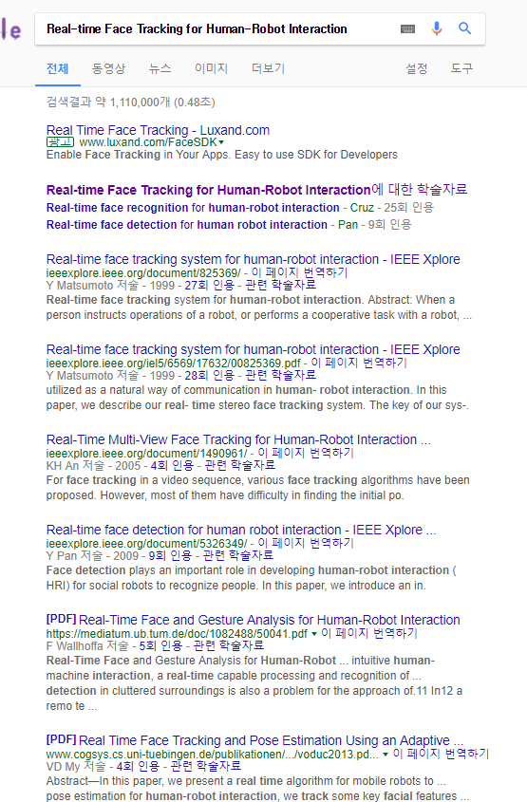
Example of Good Title
Good research paper titles (typically 10–12 words long)^{6,7} use descriptive terms and phrases that accurately highlight the core content of the paper (e.g., the species studied, the literary work evaluated, or the technology discussed).^{1,5}
Real-time Face Recognition for Human-Robot Interaction
Real-time Face Recognition for Human-Robot Interaction
Most people find articles, chapters and papers now via Google Scholar or other online sources, for instance, by searching for key or ‘trigger’ words.
What How Why
Concise and precise
Informative and relevant
Reflecting specific content
Emphasizing keywords to be indexed
Eliminating filler words or abbreviations

Slide 14
Conclusion
What
Research communication & Deduce what it is about
Good Title
Why
Impact of your work & Attract readers
How
Start with a draft
Choose what type you want to use
How to formulate your title
Write a few variants
Example of good title
Key Tips
Concise and precise
Informative and relevant
Reflecting specific content
Emphasizing keywords to be indexed
Eliminating filler words or abbreviations

Slide 15
Q&A

